Slide 1
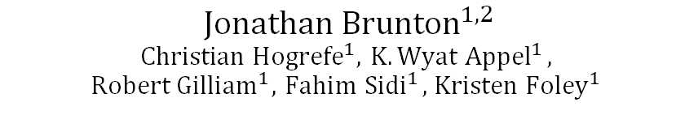
Evaluating The Relationship of Modeled Meteorology and Ozone Bias using Random Forest Regression
$${Jonathan Brunton}^{1, 2}$$
$${Christian Hogrefe}^{1}, { K. Wyat Appel}^{1},$$
$${Robert Gilliam}^{1}, { Fahim Sidi}^{1}, { Kristen Foley}^{1}$$
1
Oak Ridge Associated Universities
National Student Services Contract
2
Center for Environmental Measurement and Modeling, Atmospheric & Environmental Systems Modeling Division, Atmospheric Dynamics and Meteorology Branch
Disclaimer: The views expressed in this presentation are those of the authors and do not necessarily reflect the views or policies of the U.S. EPA.

Slide 2
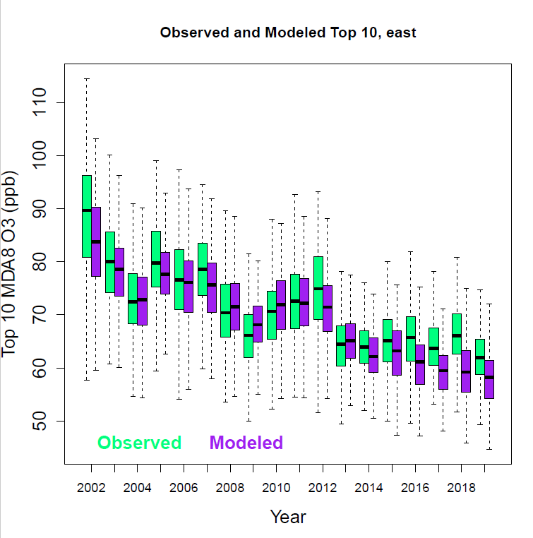
Evaluation of EQUATES (2002-2019) CMAQ outputs has revealed an increasingly negative trend in modeled ozone bias in the eastern US on highest ozone days.
General low bias of model outputs at beginning of time series (2002-2007)
Low bias reemerges with increasingly negative trend in latter portion of EQUATES (2014-2019)
All sites East of 90° (~Mississippi river)
Figure: C. Hogrefe (2023)
Center for Environmental Measurement and Modeling, Atmospheric & Environmental Systems Modeling Division, Atmospheric Dynamics and Meteorology Branch

Slide 3
WRF meteorology data available in the EQUATES domain allows for exploration of the relationship between WRF meteorology inputs and CMAQ modeled MDA8 O₃.
Quality Control and compilation of Daily WRF Meteorology Features
Features Derived from Wells et al. (2021)
This enables the investigations of:
  A.) Is bias in WRF modeled meteorology a potential driver of ozone bias?
  B.) Can trends in ozone bias be associated with trends in bias in meteorology?
  C.) Does the negative bias in ozone tend to occur during certain observed meteorological conditions?
Feature | Unit | Time | Value Range | Bias (Modeled-Observed) Range
Maximum Daily Temperature | K | 8:00-20:00 | 240, 315 | -25, 25
Average Mid-day Water Vapor Mixing Ratio | g/kg | 10:00-16:00 | 0, 30 | -20, 20
Morning Wind Speed | m/s | 7:00-10:00 | 1.5, 25 | -10, 10
Afternoon Wind Speed | m/s | 13:00-16:00 | 1.5, 25 | -10, 10
Daily Precipitation (PRISM Obs. Data*) | mm/day | Full Day | 0, Obs. Max | -50, 50
*Non-WRF; not included in Wells et al.
Center for Environmental Measurement and Modeling, Atmospheric & Environmental Systems Modeling Division, Atmospheric Dynamics and Meteorology Branch

Slide 4
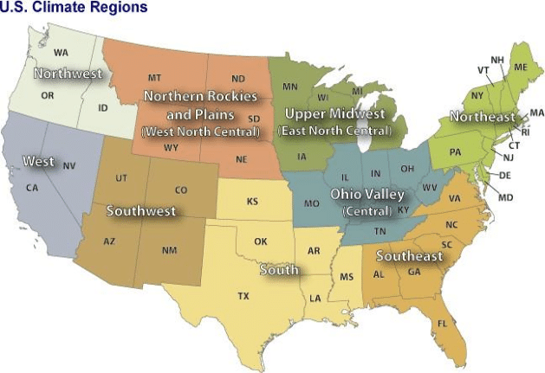
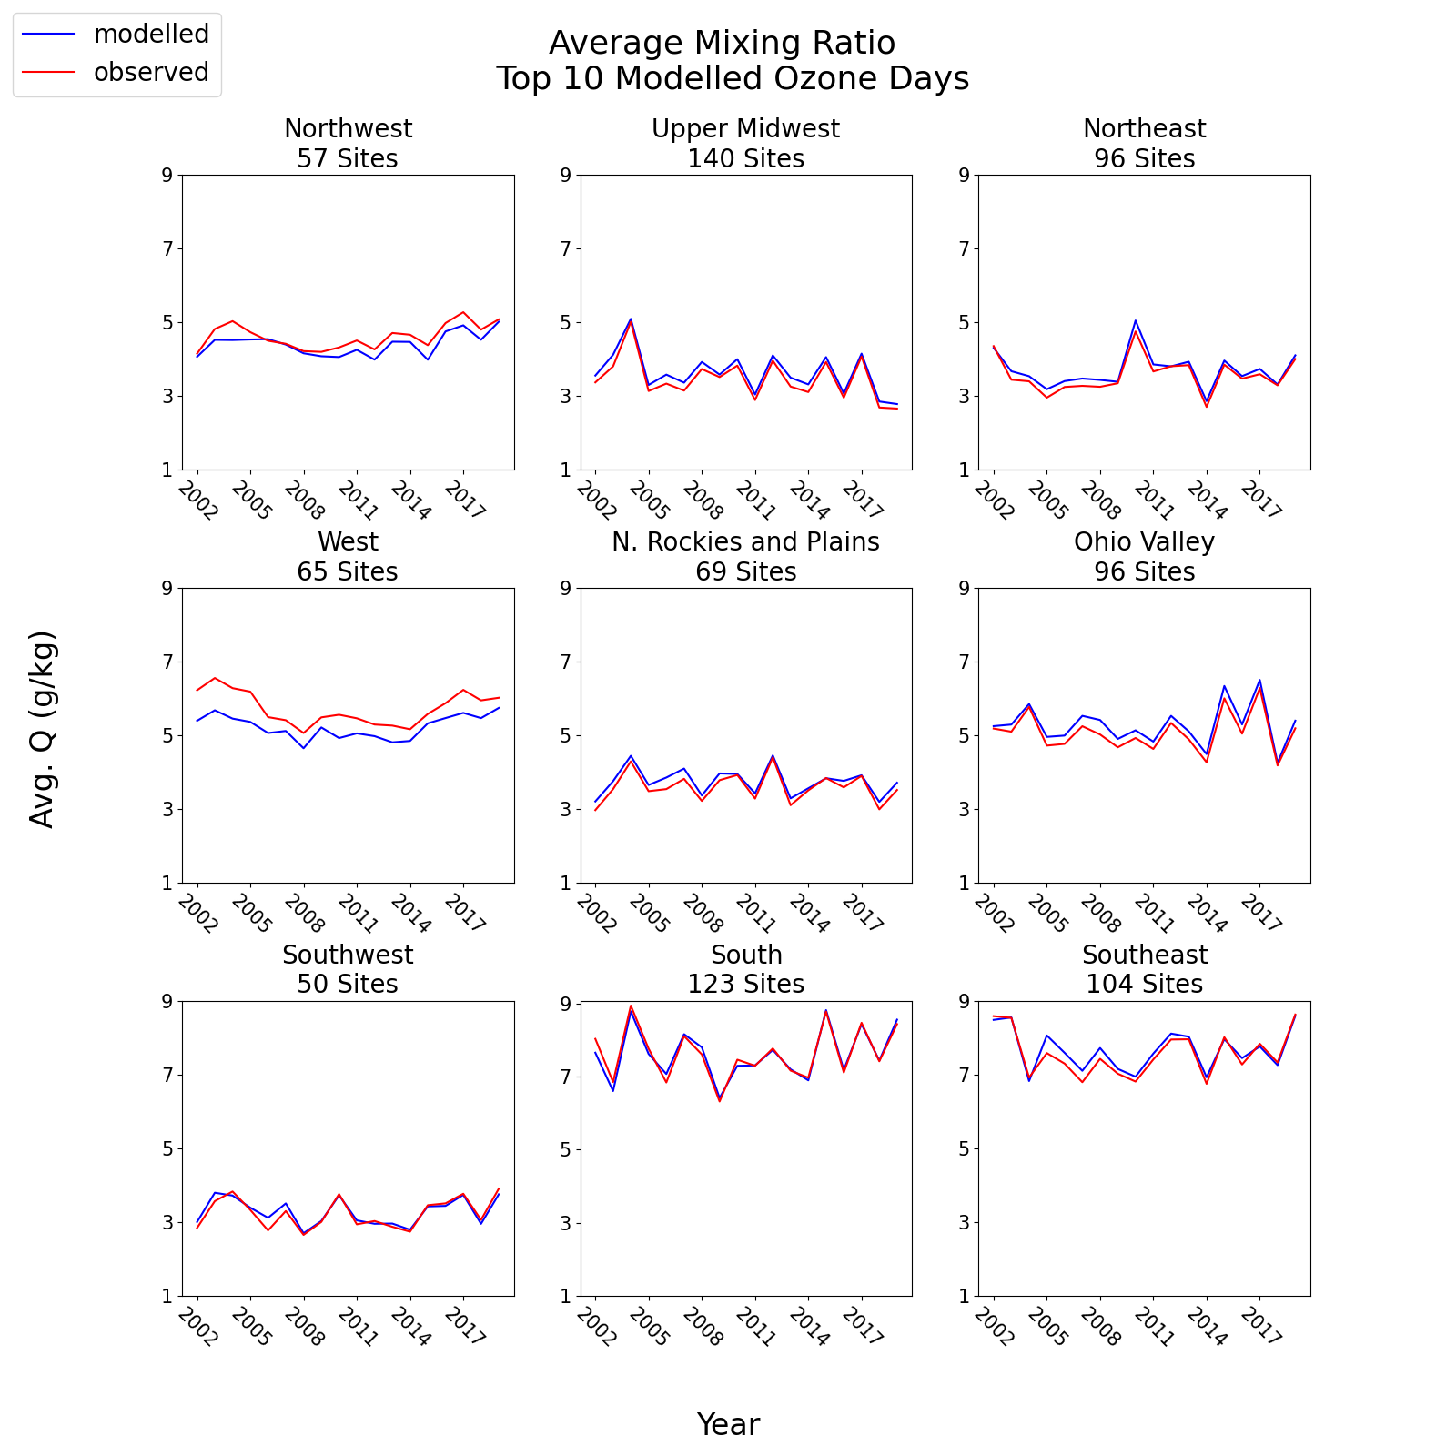
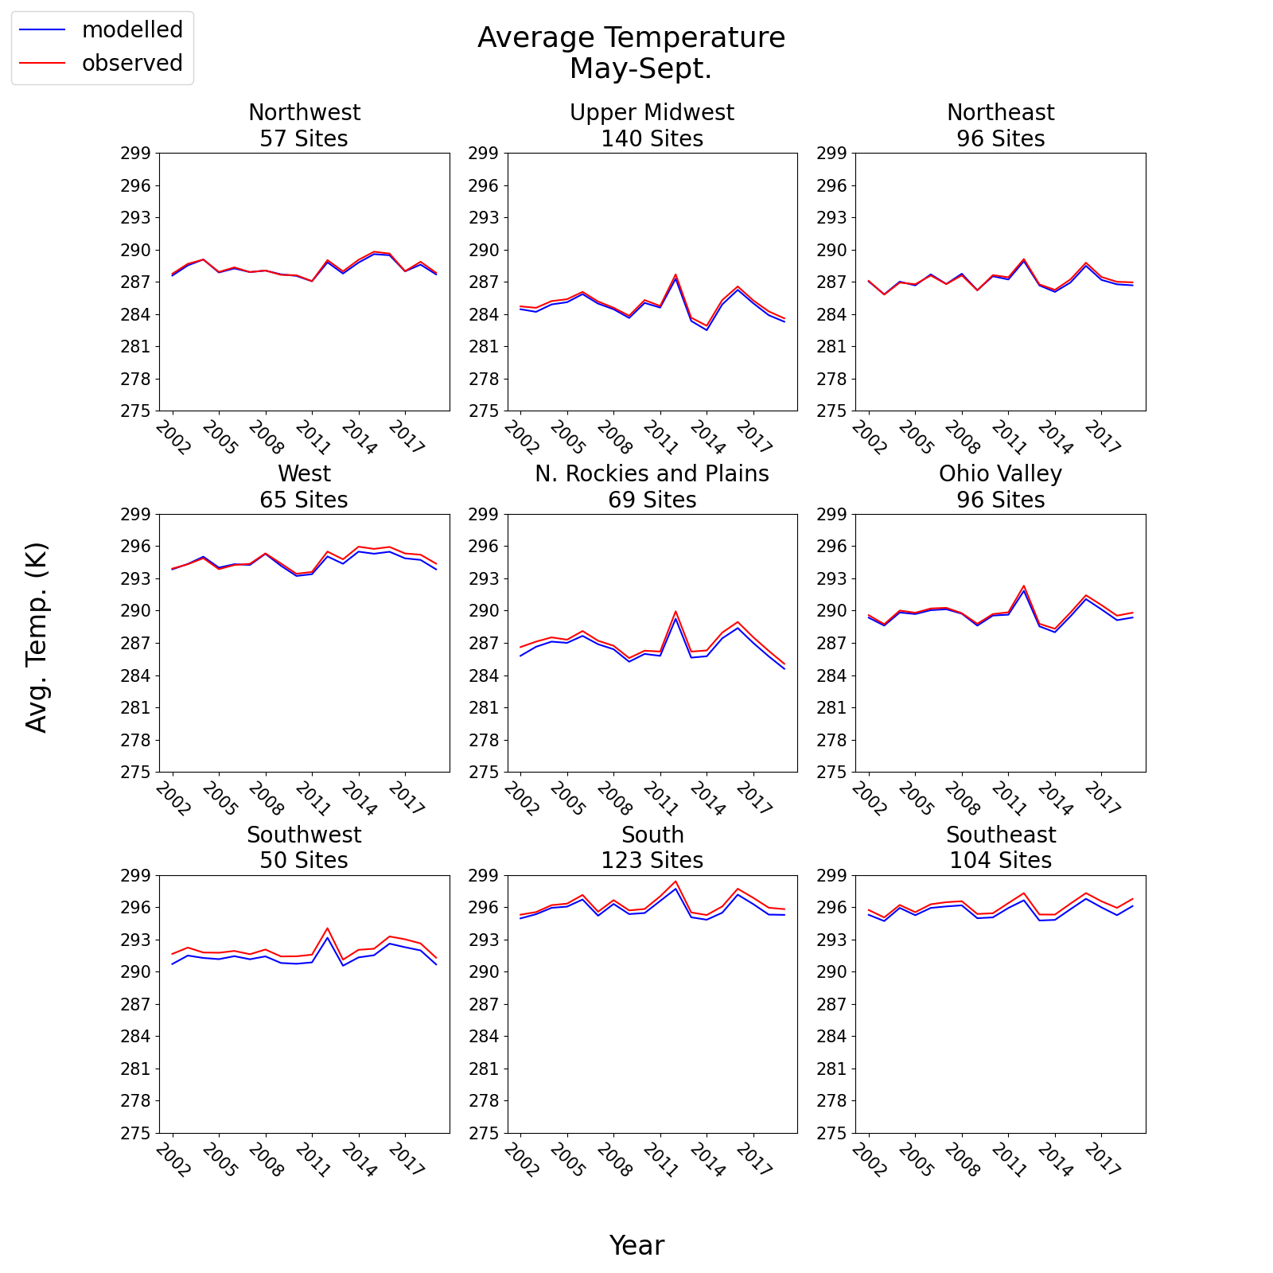
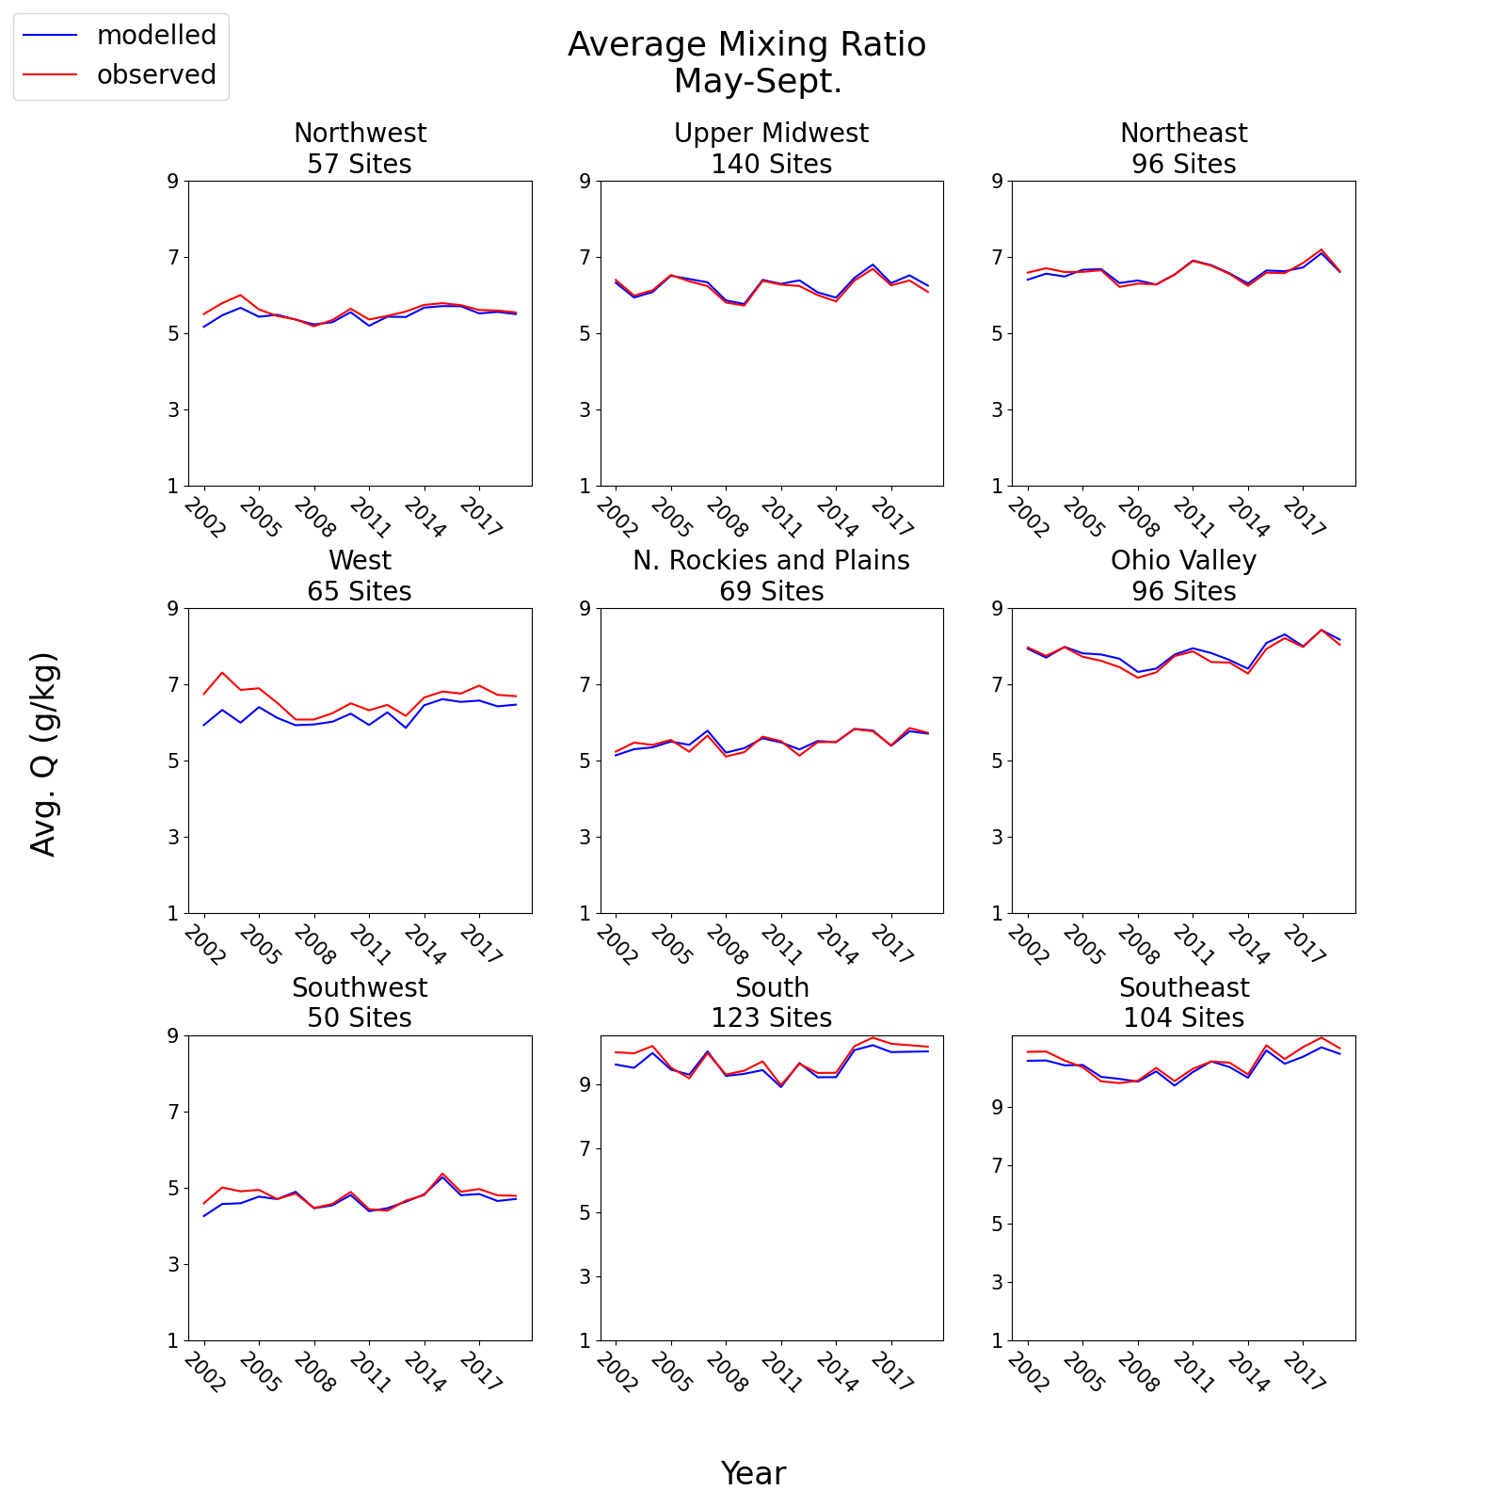
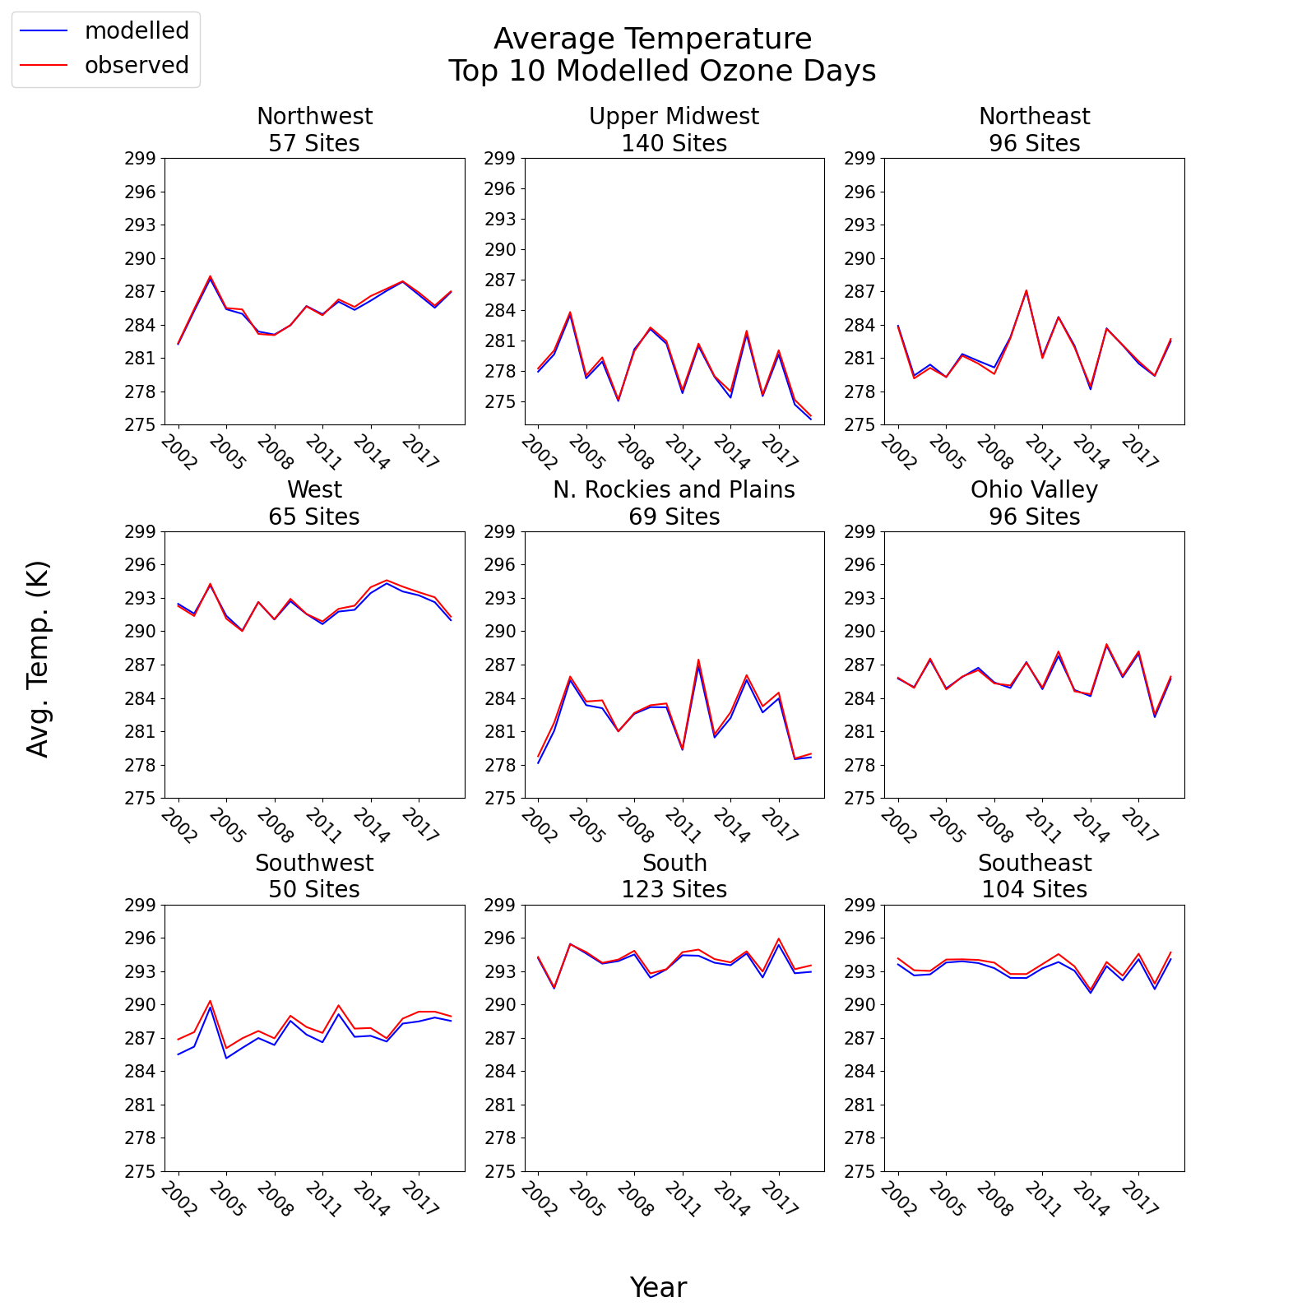
Paired meteorology-MDA8 O₃ data is grouped into NOAA climate regions.
Trends in modeled meteorology closely match those in observed meteorology throughout ozone season (left) and on top 10 modeled ozone days (right).
This is expected due to use of data assimilation in the WRF modeling via nudging.
Max. Daily Temperature (K)
Max. Daily Temperature (K)
Daytime Water Vapor Mixing Ratio (g/kg)
Daytime Water Vapor Mixing Ratio (g/kg)
Center for Environmental Measurement and Modeling, Atmospheric & Environmental Systems Modeling Division, Atmospheric Dynamics and Meteorology Branch

Slide 5
Paired meteorology-MDA8 O₃ data is grouped into NOAA climate regions.
WRF model is slightly cooler and more humid than observations in some regions/years.
On the highest observed ozone days there is more bias in modeled mixing ratio than temperature. Mixing Ratio is not nudged as strongly as temperature.
Max. Daily Temperature (K)
Max. Daily Temperature (K)
Daytime Water Vapor Mixing Ratio (g/kg)
Daytime Water Vapor Mixing Ratio (g/kg)
Center for Environmental Measurement and Modeling, Atmospheric & Environmental Systems Modeling Division, Atmospheric Dynamics and Meteorology Branch

Slide 6
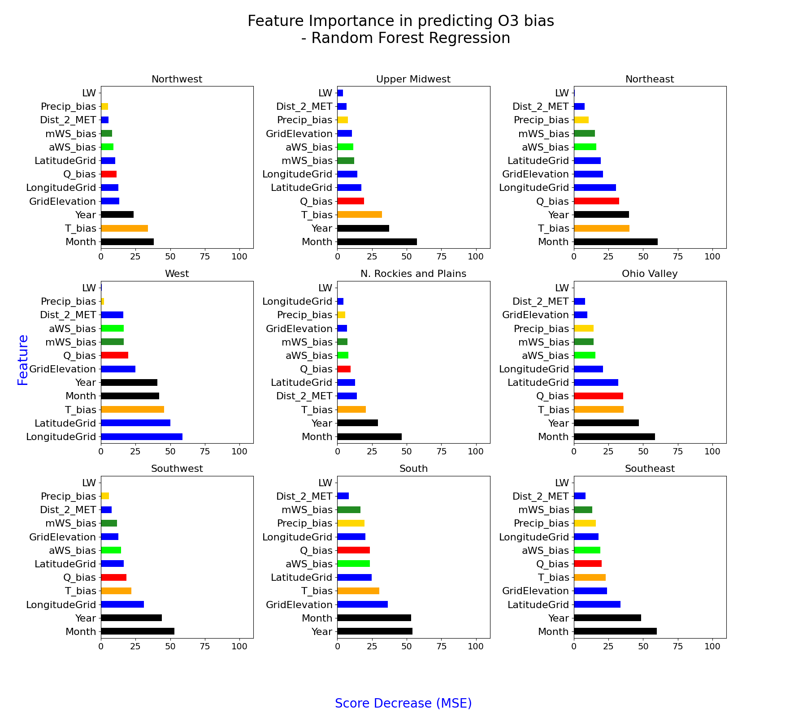
Random Forest (RF) Regression models are developed regionally to evaluate the predictive power of meteorology features in capturing ozone bias throughout peak ozone season (May-September).
Feature Importance
Feature Permutation evaluates relative importance of each feature independent of all other features.
Optimized model versions are trained on bias in met features as well as spatio-temporal features (land/water classification, Lat./Lon., Month, Year) included as surrogates for other drivers of model ozone bias.
Best predictors of ozone bias are year and month, indicating bias in modeled meteorology is not a primary driver for ozone bias.
Bias in temperature and mixing ratio have more predictive power than bias in windspeed and precipitation.
RF Features
Temperature Bias
Mixing Ratio Bias
Afternoon WS Bias
Morning WS Bias
Precipitation Bias
Non-WRF Bias Surrogates
Model Month/Year
Center for Environmental Measurement and Modeling, Atmospheric & Environmental Systems Modeling Division, Atmospheric Dynamics and Meteorology Branch
Model Score decrease (MSE)

Slide 7
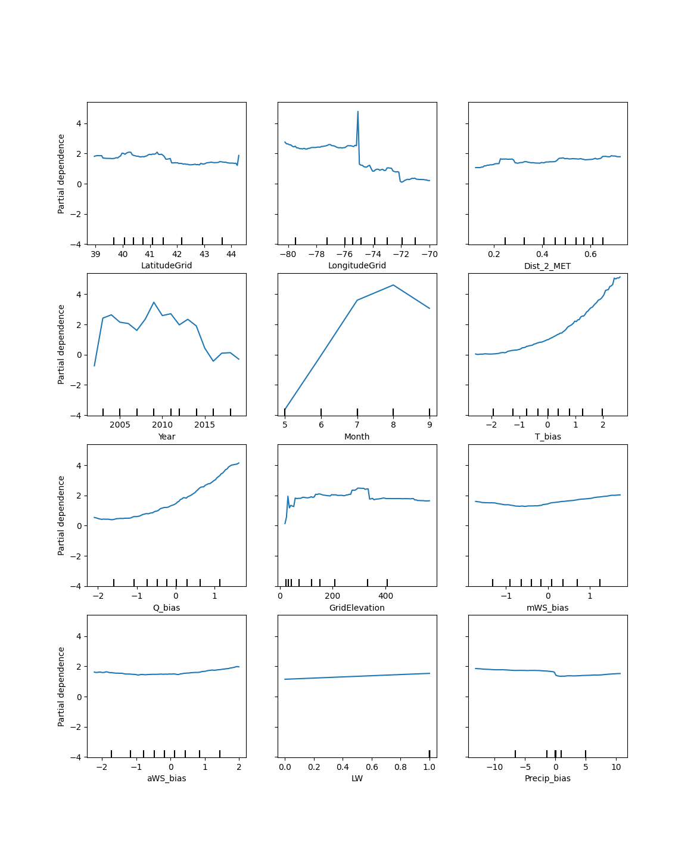
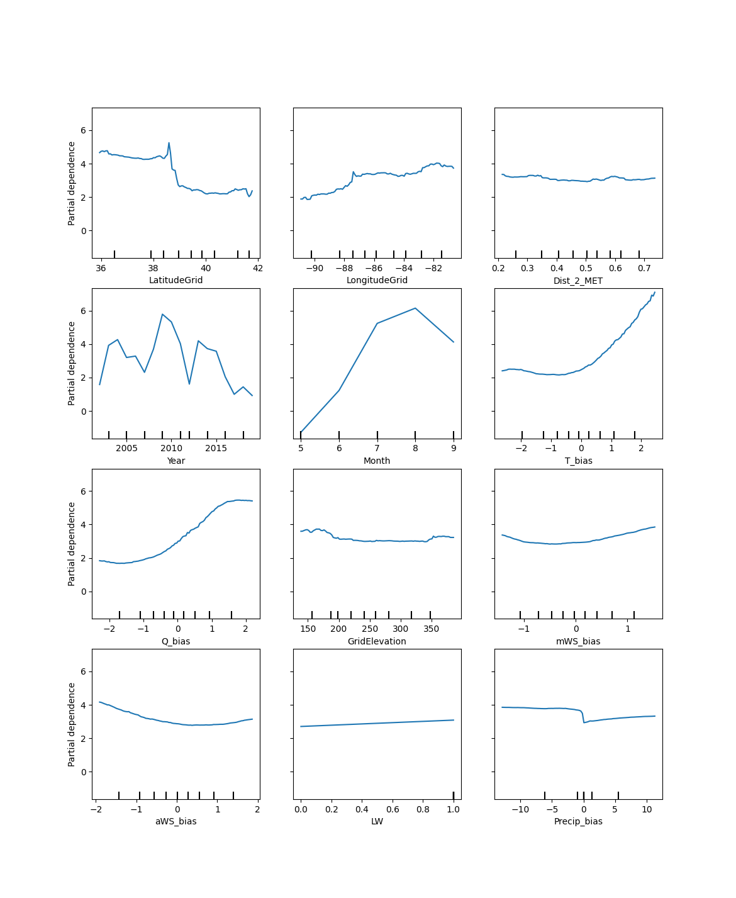
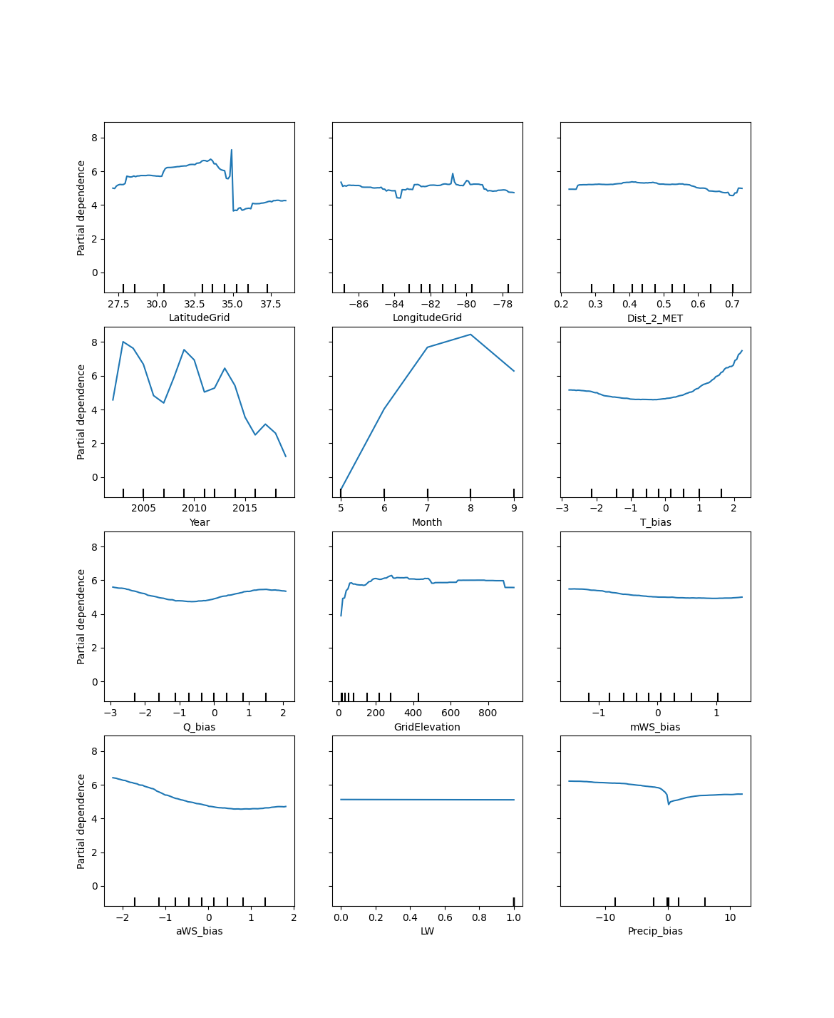
Northeast Region
Y = Partial Dependence = Average O3 Bias Prediction at X value
Ohio Valley Region
Southeast Region
Center for Environmental Measurement and Modeling, Atmospheric & Environmental Systems Modeling Division, Atmospheric Dynamics and Meteorology Branch

Slide 8
Northeast Region
Y = Partial Dependence = Average O3 Bias Prediction at X value
Month
Temp. Bias
Q Bias
Ohio Valley Region
Predictive power shown by any (non-zero) trends across Feature Value Range (X-axis). Features with higher predictive power have greater ozone bias distributions as X values increase.
Southeast Region
Month
Temp. Bias
Q Bias
Month
Temp. Bias
Q Bias
Center for Environmental Measurement and Modeling, Atmospheric & Environmental Systems Modeling Division, Atmospheric Dynamics and Meteorology Branch

Slide 9
Northeast Region
Y = Partial Dependence = Average O3 Prediction at X value
Ohio Valley Region
Consistent trend across regions in model years, decreasing ozone bias in later half of time series
High predictive power shown in Month across regions, with low-to-negative ozone bias being prominent in early ozone season months
Southeast Region
Center for Environmental Measurement and Modeling, Atmospheric & Environmental Systems Modeling Division, Atmospheric Dynamics and Meteorology Branch

Slide 10
Northeast Region
Y = Partial Dependence = Average O3 Prediction at X value
Temperature and Mixing Ratio Bias each show a relationship with ozone bias at greater values for most regions, but unable to predict ozone bias at negative values.
Wind Speed, Precipitation have very little relationship with ozone bias.
Ohio Valley Region
Southeast Region
Center for Environmental Measurement and Modeling, Atmospheric & Environmental Systems Modeling Division, Atmospheric Dynamics and Meteorology Branch

Slide 11
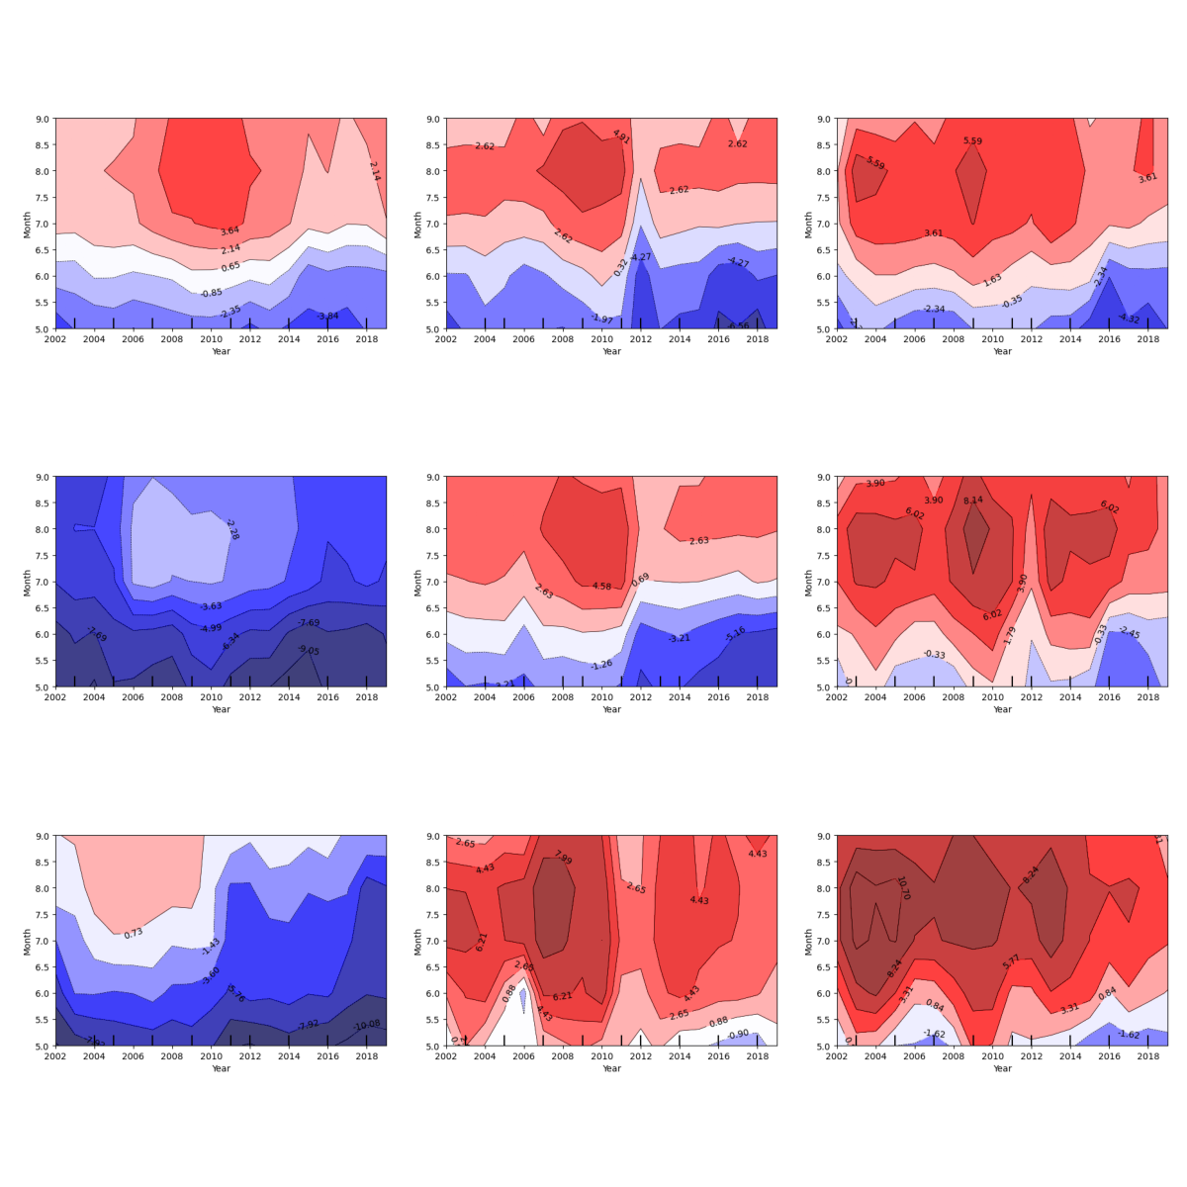
The trained feature importance inherited by RF models allows for investigation into feature relationships with ozone bias through time.
2-way Partial Dependence Analysis:
Many decision trees (ML sub-models) in a Random Forest predict O3 bias by splitting data into random subsets (random feature value distributions)
Contour Interpretation:
  For a subset with a given average Feature X (Year) and average Feature Y (Month), the model makes an average O3 bias prediction.
- Avg. X in subset(Year): ~2006
- Avg. Y in subset (Month): ~8.0
- Avg. predicted O3 Bias: 3.61-5.59 ppb
Northeast Region
Center for Environmental Measurement and Modeling, Atmospheric & Environmental Systems Modeling Division, Atmospheric Dynamics and Meteorology Branch

Slide 12
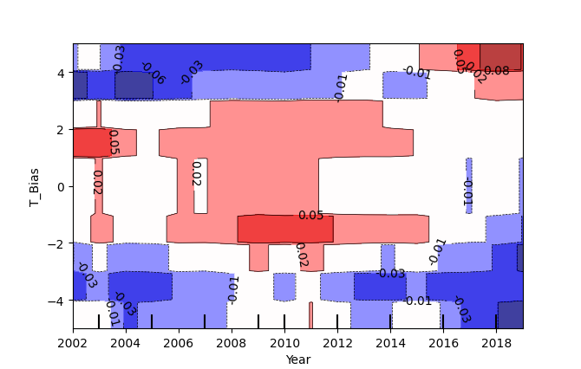
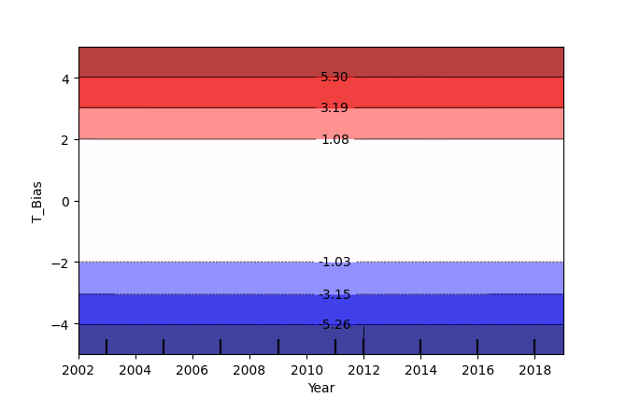
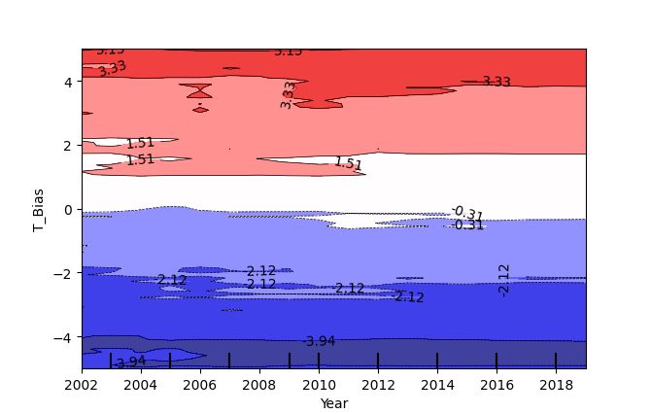
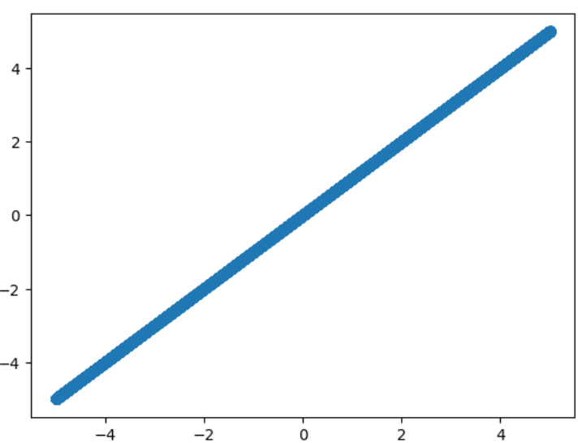
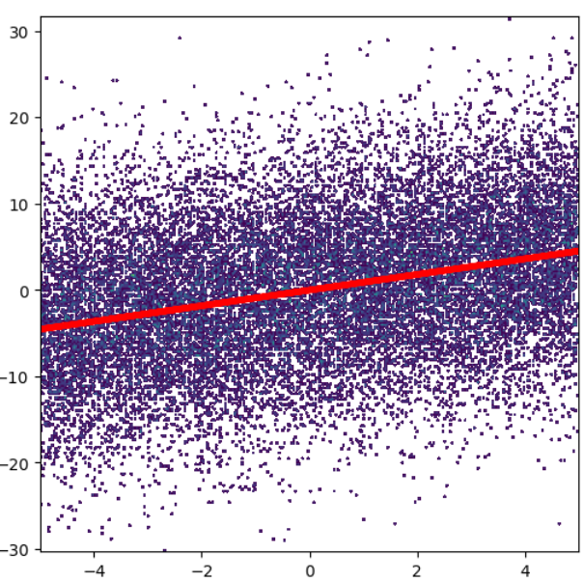
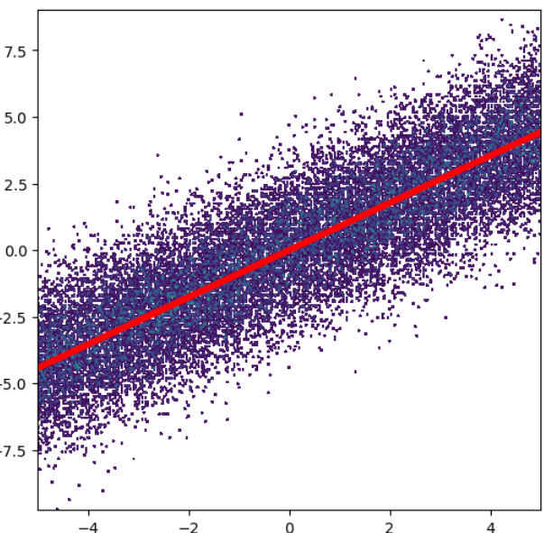
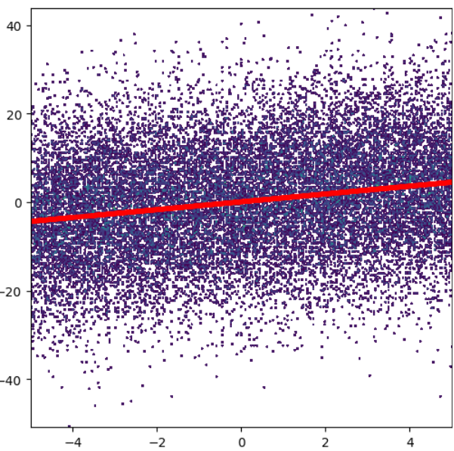



The trained feature importance inherited by RF models allows for investigation into feature relationships with ozone bias through time.
2-way Partial Dependence Analysis (Idealized Scenarios):
Temp. Bias perfectly correlated to Ozone Bias
i.e., horizontal contours indicate Temp. Bias is a ‘perfect’ predictor of Ozone Bias with no temporal change.
Converging Trend in Negative and Positive Bias.
i.e. stronger predictive power in later model years.
Insignificant (~0) correlation
Temp. Bias
Temp. Bias
Temp. Bias
Year = 2002-2019
Year = 2002
$$r^{2}=0.206$$
Year = 2011
$$r^{2}=0.319$$
Year = 2019
$$r^{2}=0.856$$
O3 Bias
O3 Bias
O3 Bias
O3 Bias
Temp. Bias
Temp. Bias
Temp. Bias
Temp. Bias
Center for Environmental Measurement and Modeling, Atmospheric & Environmental Systems Modeling Division, Atmospheric Dynamics and Meteorology Branch

Slide 13

Partial Dependence Analysis
Ozone bias as a function of Month and Year
Month
In the Eastern US low ozone bias tends to occur in spring months, May – June.
The magnitude of this low bias increases at the end of the timeseries, consistent with the boxplots shown earlier.
The Southeast shows the largest ozone overestimation of the three regions, with high bias peaking in July/August of 2002-2005.
O3 Bias (ppb)
Northeast
Ohio Valley
Month
Southeast
Month
Center for Environmental Measurement and Modeling, Atmospheric & Environmental Systems Modeling Division, Atmospheric Dynamics and Meteorology Branch

Slide 14
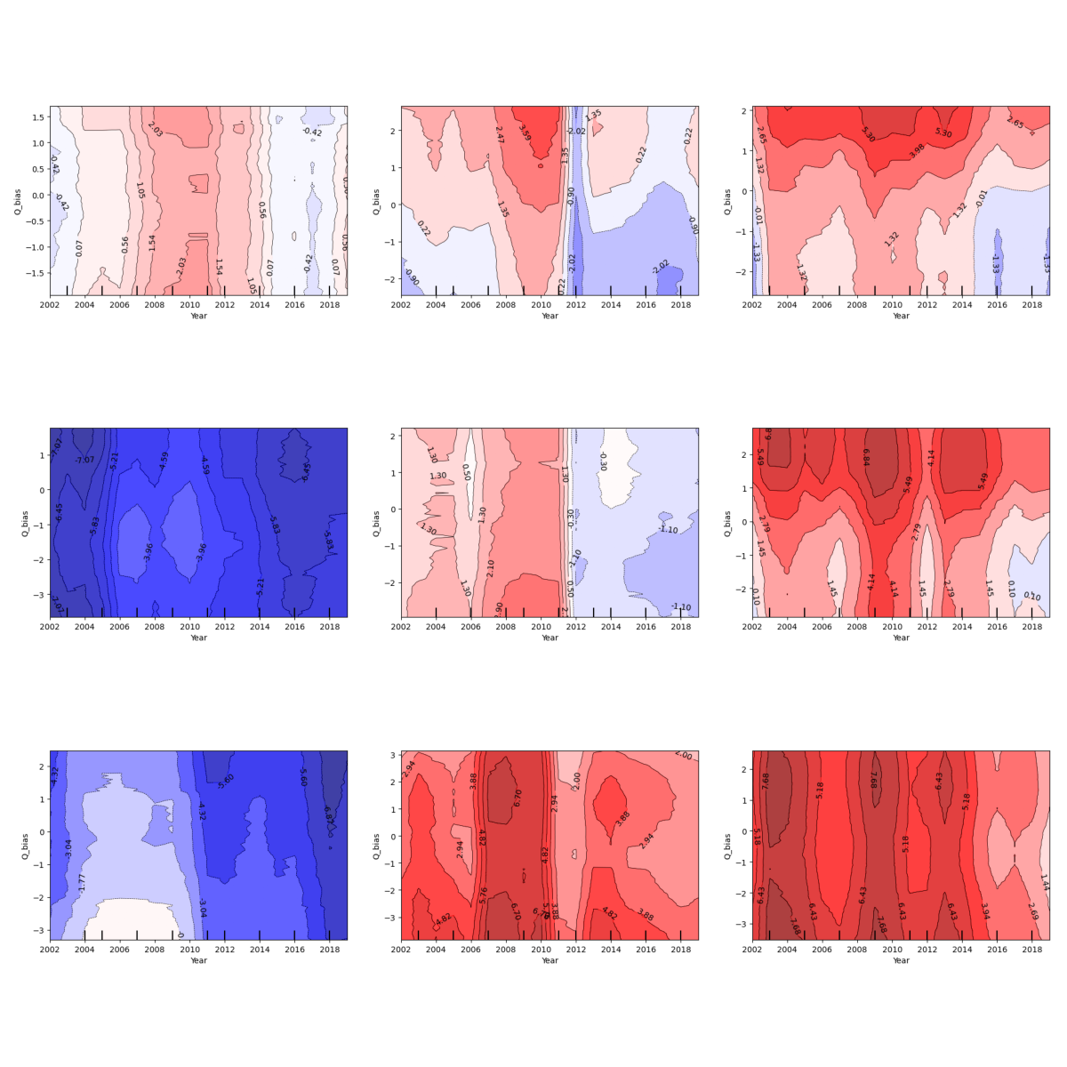
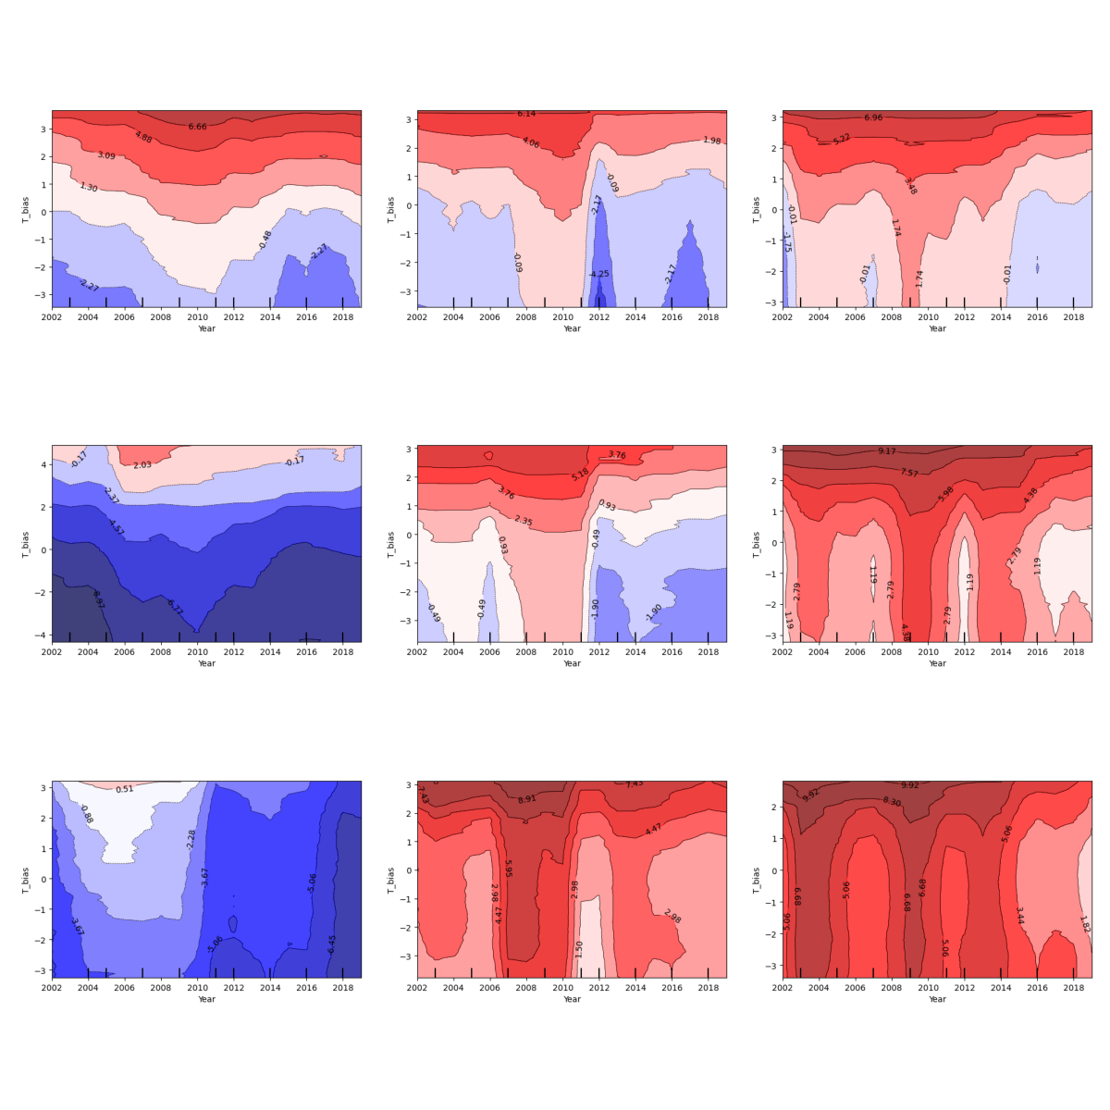
Partial Dependence Analysis
Ozone bias as a function of Temp./Q Bias and Year
O3 Bias (ppb)
Northeast:
  Mixing Ratio/Temp. Bias associated with positive ozone bias at positive values (horizontal contours).
  Negative bias in both negative mixing ratios and temps. begins to be associated with some negative ozone bias in 2015-2019. No strong linear relationship (lack of horizontal contours).
Southeast:
  Little to no relationship between mixing ratio and temperature bias in all conditions (vertical contours).
Ohio Valley:
  Association between mixing ratio bias and ozone bias changes from year to year.
  Temp. bias remains a powerful predictor of positive ozone bias only, and only at positive values.
Northeast
Northeast
Ohio Valley
Ohio Valley
Mixing Ratio Bias
Temperature Bias
Southeast
Southeast
Center for Environmental Measurement and Modeling, Atmospheric & Environmental Systems Modeling Division, Atmospheric Dynamics and Meteorology Branch

Slide 15
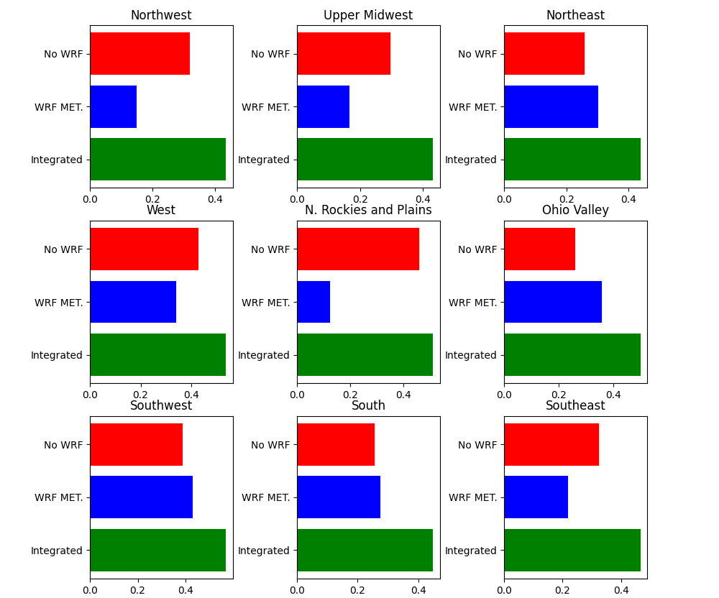
Evaluating how well the RF model captures explained variability (R2 score) in ozone bias across regions shows:
  The combination of WRF and non-WRF features captures up to 45-55% of the explained variability in modeled ozone bias (additionally serving as a baseline for future investigations)
  The relationship between WRF meteorology bias and ozone bias is stronger in the Northeast, Ohio Valley, South, Southwest, and West (relative to other regions).
Non-WRF | WRF Only | ‘Integrated’
Year | Temp. Bias | All Features
Month | Q Bias
Latitude | Morning WS Bias
Longitude | Afternoon WS Bias
Grid Bias | Precip. Bias
Land Class.
Center for Environmental Measurement and Modeling, Atmospheric & Environmental Systems Modeling Division, Atmospheric Dynamics and Meteorology Branch

Slide 16
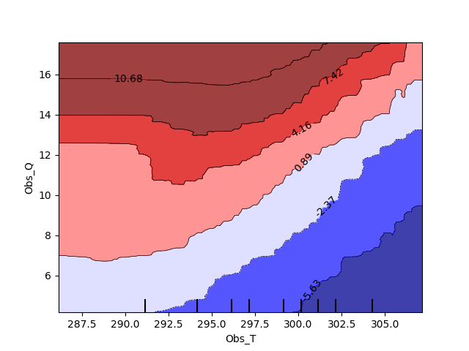
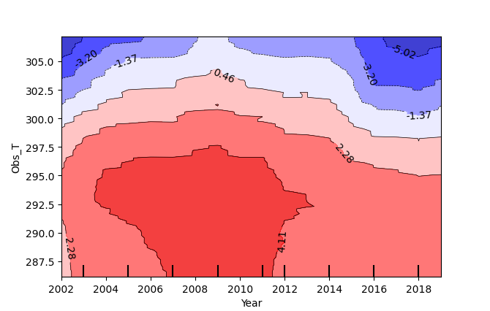
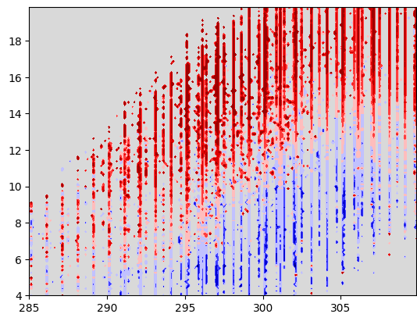
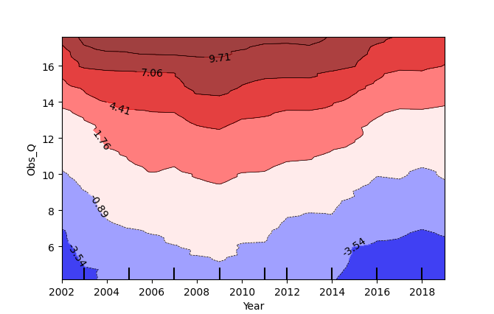
The RF model captures a low ozone bias concurrent with higher temperature and lower mixing ratios, consistent with ground truth data.
Northeast Region
A separate RF model was fit using observed meteorology (rather than met bias).
CMAQ generally over-predicts ozone in very humid conditions and generally under-predicts ozone in hot and dry conditions.
Obs. Max. Temperature (K)
Obs. Mixing Ratio (g/kg)
Ground truth
Obs. Mixing Ratio (g/kg)
Obs. Max. Temperature (K)
Year
Center for Environmental Measurement and Modeling, Atmospheric & Environmental Systems Modeling Division, Atmospheric Dynamics and Meteorology Branch

Slide 17
Summary and Future Development
Bias in meteorology was found to have a weak association with ozone bias and does not explain the increase in negative bias at the end of the time series.
Future work
Investigate other possible meteorological drivers of ozone bias such as solar radiation and cloud cover
Train RF model on high ozone days only
Incorporate emissions information
  → While there is currently no direct emissions bias data, we can use source contribution to modeled ozone concentrations (based on CMAQ ISAM modeling) to explore if negative ozone bias is higher in conditions dominated by a certain source category (see table).
CMAQ v5.4 – Integrated Source Apportionment Method (ISAM) Species Categories:
Source Category | Source Category
US Mobile Onroad | US Mobile Nonroad
US Mobile airports, commercial marine vessels, rail | US Oil and Gas
US EGUs (Power Plants) | US Volatile Chemical Products
US Anthropogenic Fires | US Anthropogenic Other-All
Natural Sources | US Wildfires, all Canadian and Mexican fires
Canada and Mexico Anthropogenic Sources | Boundary Conditions
Center for Environmental Measurement and Modeling, Atmospheric & Environmental Systems Modeling Division, Atmospheric Dynamics and Meteorology Branch

Slide 18
References
EQUATES. (2024, March 24), https://www.epa.gov/cmaq/equates
Wells et al., 2021, “Improved estimation of trends in U.S. ozone concentrations adjusted for interannual variability in meteorological conditions”, Atmospheric Environment, https://doi.org/10.1016/j.atmosenv.2021.118234
The Integrated Source Apportionment Method (CMAQ-ISAM). (2024, Sept. 4), https://www.epa.gov/cmaq/integrated-source-apportionment-method-cmaq-isam
Scikit-learn: Machine Learning in Python, Pedregosa et al., JMLR 12, pp. 2825-2830, 2011.
  Random Forest Regressor [Computer Software], https://scikit-learn.org/stable/modules/generated/sklearn.ensemble.RandomForestRegressor.html
  Permutation feature importance [Computer Software], https://scikit-learn.org/stable/modules/permutation_importance.html
Center for Environmental Measurement and Modeling, Atmospheric & Environmental Systems Modeling Division, Atmospheric Dynamics and Meteorology Branch

Slide 19
Additional Materials
Center for Environmental Measurement and Modeling, Atmospheric & Environmental Systems Modeling Division, Atmospheric Dynamics and Meteorology Branch

Slide 20
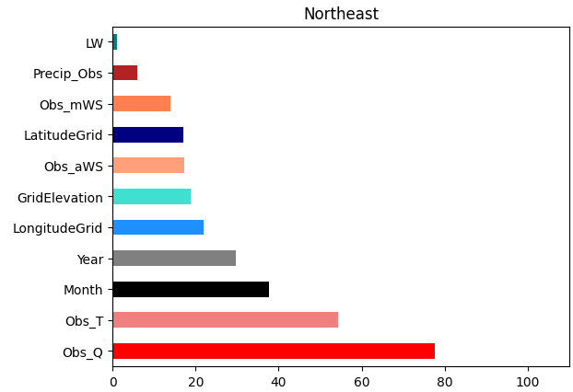
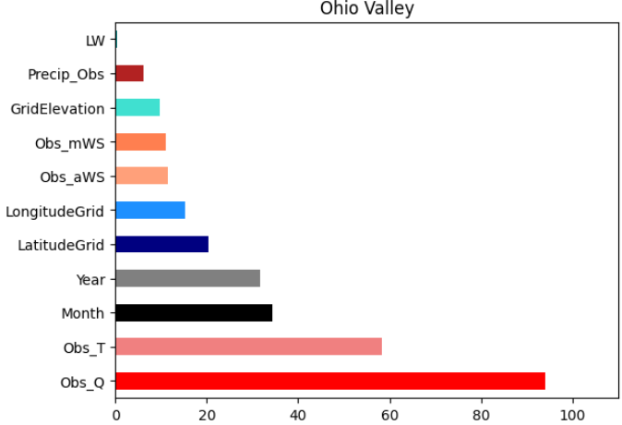
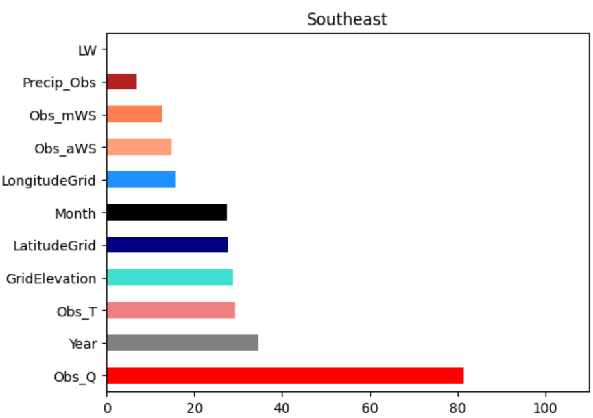
A Random Forest (RF) Regression model is developed for each region to evaluate the predictive power of meteorology features in capturing ozone bias.
Feature Importance – Observed Met
A separate RF model was fit using observed meteorology (rather than met bias).
Generally, observed temperature and mixing ratio are best predictors for ozone bias.
Spatiotemporal features have a major influence (relative to other Met. features).
Model Score decrease (MSE)
Center for Environmental Measurement and Modeling, Atmospheric & Environmental Systems Modeling Division, Atmospheric Dynamics and Meteorology Branch

Slide 21
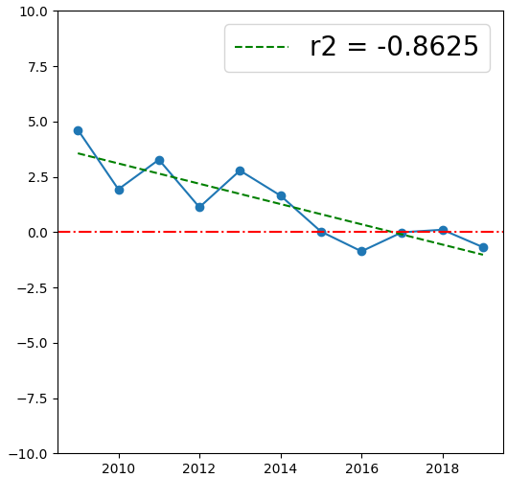
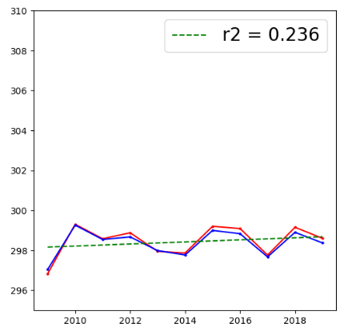
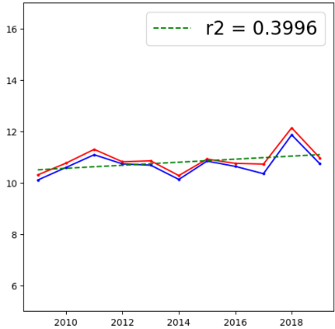
While WRF Temperature and Mixing Ratio are associated with ozone bias, trends of these features are not as strong as that seen in ozone bias.
Northeast Region
O₃ Bias (ppb)
Max. Temp. (K)
Mixing Ratio (g/kg)
Center for Environmental Measurement and Modeling, Atmospheric & Environmental Systems Modeling Division, Atmospheric Dynamics and Meteorology Branch

Slide 22
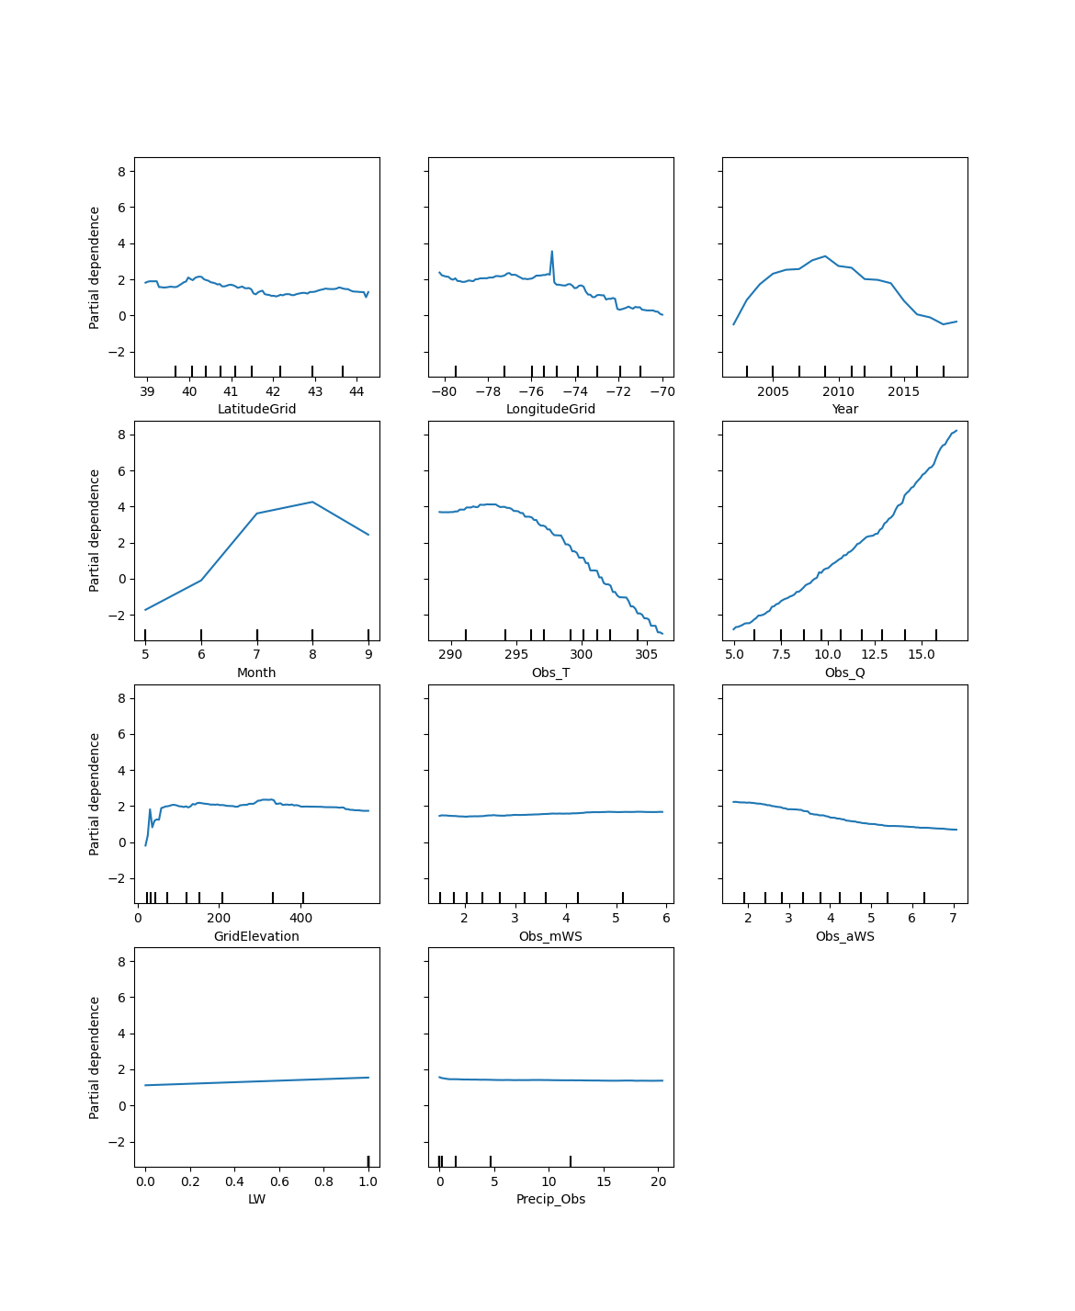
While WRF Temperature and Mixing Ratio are associated with ozone bias, trends of these features are not as strong as that seen in ozone bias.
Northeast Region
Lat.
Lon.
Year
Max. Temp. (K)
Month
Obs. Temp.
Obs. Mix. Ratio
O₃ Bias (ppb)
v
Elevation Bias
Obs. Wind Speed (morn.)
Obs. Wind Speed (aft.)
Mixing Ratio (g/kg)
Land Class.
Obs. Precip.
Center for Environmental Measurement and Modeling, Atmospheric & Environmental Systems Modeling Division, Atmospheric Dynamics and Meteorology Branch

Slide 23
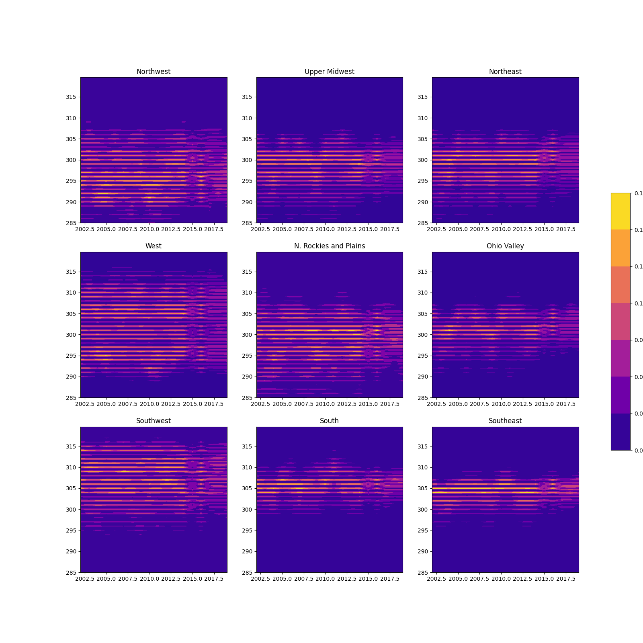
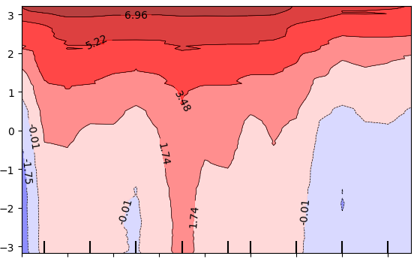
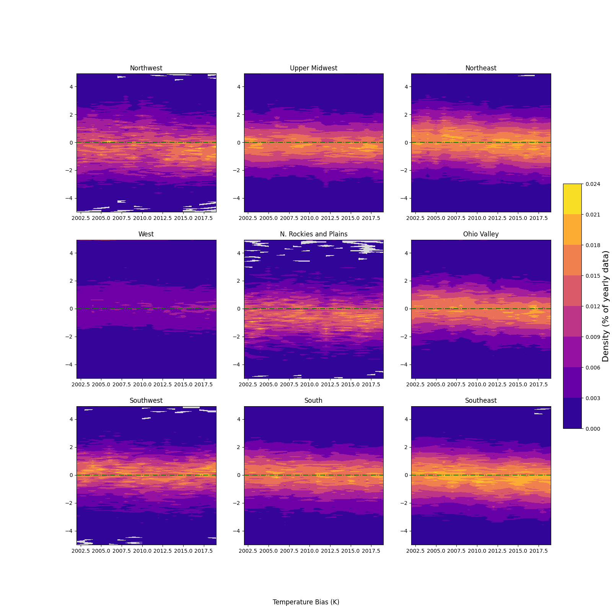
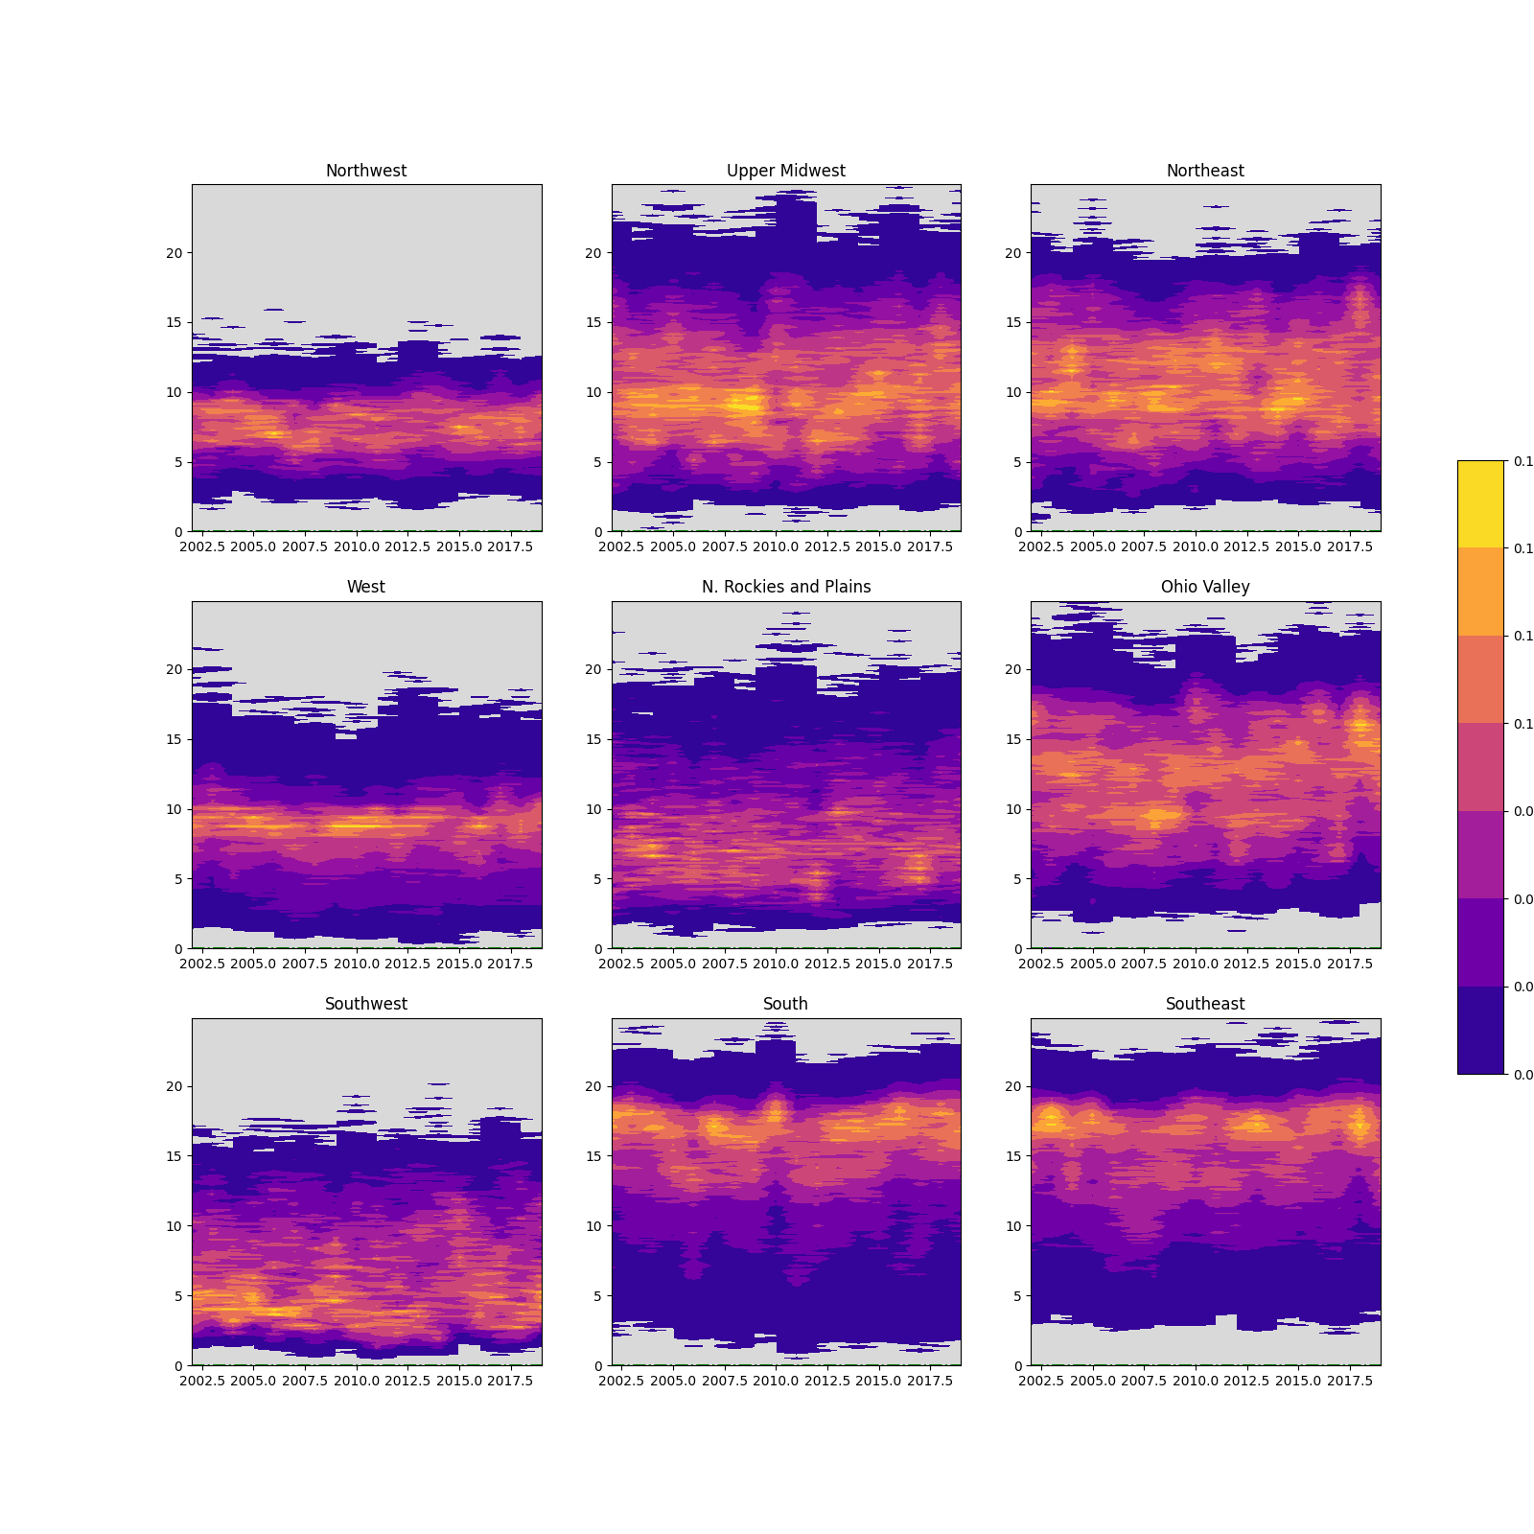
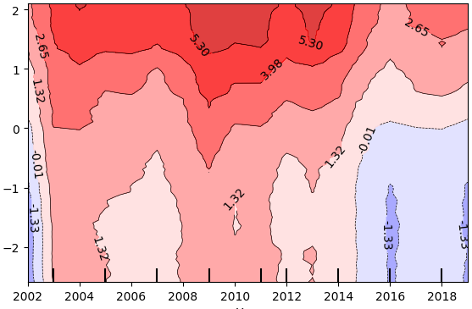
Overall, the bias and observed conditions in the most notable meteorology features reveal no matching trends to that seen in ozone bias.
Northeast Region
Ground truth density of average yearly values.
No trends shown, limitations on model prediction domain shown (95 % of data)
Temperature Bias (K)
Obs. Max. Temperature (K)
Mixing Ratio Bias (g/kg)
Obs. Mixing Ratio (g/kg)
Year
Year
Center for Environmental Measurement and Modeling, Atmospheric & Environmental Systems Modeling Division, Atmospheric Dynamics and Meteorology Branch

Slide 24
Interpreting 1-way Partial Dependence Plots
- Avg. X in subset(Year): ~2005
- Avg. predicted O3 Bias: ~ 2 ppb
Lat.
Lon.
Year
Month
Obs. Temp.
Obs. Mix. Ratio
- X ticks show the decile ranges (every 10% of data volume) of the X feature

